Slide 1
Средства по работе с XML и JSON
CROC Java School 2020

Slide 2
The structure of an XML document
An XML document should start with a header such as
<?xml version="1.0"?>
or
<?xml version="1.0" encoding="UTF-8"?>
Strictly speaking, a header is optional, but it is highly recommended.
The header can be followed by a document type definition (DTD), such as
<!DOCTYPE web-app PUBLIC
"-//Sun Microsystems, Inc.//DTD Web Application 2.2//EN"
"http://java.sun.com/j2ee/dtds/web-app_2_2.dtd">
Notes:
DTDs are an important mechanism to ensure the correctness of a document, but they are not required. We will discuss them later in this chapter.

Slide 3
The structure of an XML document
<?xml version="1.0"?>
<!DOCTYPE config . . .>
<config>
<entry id="title">
<font>
<name>Helvetica</name>
<size>36</size>
</font>
</entry> ...
</config>
Notes:
Finally, the body of the XML document contains the root element, which can contain other elements.
An element can contain child elements, text, or both. In the preceding example, the font element has two child elements, name and size. The name element contains the text "Helvetica".

Slide 4
The structure of an XML document
Mixed Content
<font>
Helvetica
<size>36</size>
</font>
Attribute Description
<font name="Helvetica" size="36 pt"/>
Better use
<font>
<name>Helvetica</name> <size unit="pt">
36
</size>
</font>
Notes:
It is best to structure your XML documents so that an element contains either child elements or text. Here’s an example of what you should avoid
This is called mixed content in the XML specification. As you will see later in this chapter, you can simplify parsing if you avoid mixed content.
XML elements can contain attributes, such as
There is some disagreement among XML designers about when to use elements and when to use attributes. For example, it would seem easier to describe a font as
it done on the second example.
However, attributes are much less flexible. Suppose you want to add units to the size value. If you use attributes, you will have to add the unit to the attribute value.
A commonly used rule of thumb is that attributes should be used only to modify the interpretation of a value, not to specify values. If you find yourself engaged in a metaphysical discussion about whether a particular setting is a modification of the interpretation of a value or not, just say “no” to attributes and use elements throughout. Many useful XML documents don’t use attributes at all.

Slide 5
Parsing an XML document
Tree parsers – Document Object Model (DOM) parser
Streaming parsers – Simple API for XML (SAX) parser
Notes:
To process an XML document, you need to parse it. A parser is a program that reads a file, confirms that the file has the correct format, breaks it up into the constituent elements, and lets a programmer access those elements. The Java library supplies two kinds of XML parsers
Tree parsers, such as a Document Object Model (DOM) parser, that read an XML document into a tree structure.
Streaming parsers, such as a Simple API for XML (SAX) parser, that generate events as they read an XML document.
DOM parsers are easier to use for most purposes, so we explain them first. You may consider a streaming parser if you process very long documents whose tree structures would use up a lot of memory, or if you are only interested in a few elements and don’t care about their context.

Slide 6
DOM parser
DocumentBuilderFactory factory = DocumentBuilderFactory.newInstance();
DocumentBuilder builder = factory.newDocumentBuilder();
Read a document from a file:
File f = . . .; Document doc = builder.parse(f);
Read a document from a URL:
URL u = . . .;
Document doc = builder.parse(u);
Read a document from an input stream:
InputStream in = . . .; Document doc = builder.parse(in);
Notes:
To read an XML document, you need a DocumentBuilder object that you get from a DocumentBuilderFactory like this:

Slide 7
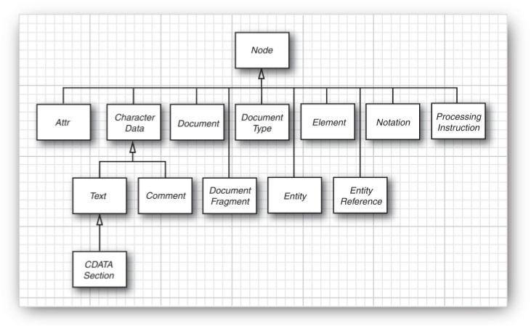
Document object
Notes:
A Document object is an in-memory representation of the tree structure of an XML document. It is composed of objects whose classes implement the Node interface and its various subinterfaces. Figure shows the inheritance hierarchy of the subinterfaces.

Slide 8
Parsing an XML document
<font>
<name>Helvetica</name>
<size unit="pt">36</size>
</font>
Element root = doc.getDocumentElement(); // font element
String name = root.getTagName(); // "font"
NodeList children = root.getChildNodes(); for (int i = 0; i < children.getLength(); i++) {
Node child = children.item(i);
...
String unit = element.getAttribute("unit"); // "pt"
}
Notes:
Start analyzing the contents of a document by calling the getDocumentElement method. It returns
the root element. For example, if you are processing a document like on the screen then calling getDocumentElement returns the font element.
The getTagName method returns the tag name of an element. In the preceding example,
root.getTagName() returns the string "font".
To get an element’s children (which may be subelements, text, comments, or other nodes), use the getChildNodes method. That method returns a collection of type NodeList. That type was standardized before the standard Java collections, so it has a different access protocol. The item method gets the item with a given index, and the getLength method gives the total count of the items. You can enumerate all children like this:
Be careful when analyzing children. Suppose, for example, that you are processing the document
You would expect the font element to have two children, but the parser reports five:
The whitespace between <font> and <name> The name element The whitespace between </name> and <size>
The size element
The whitespace between </size> and </font>

Slide 9
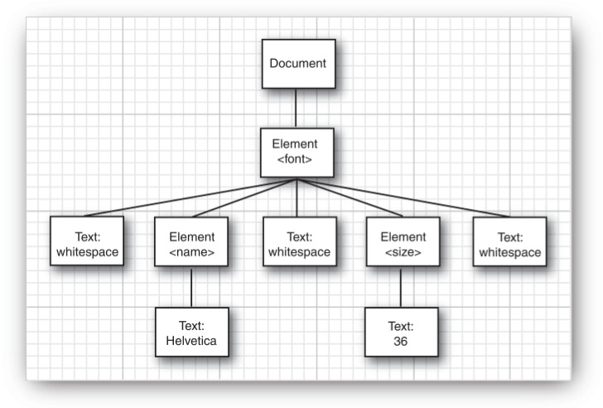

Slide 10
Parsing an XML document
for (int i = 0; i < children.getLength(); i++) {
Node child = children.item(i);
if (child instanceof Element) {
var childElement = (Element) child; var textNode = (Text) childElement.getFirstChild();
String text = textNode.getData().trim(); if (childElement.getTagName().equals("name")) {
name = text;
} else if (childElement.getTagName().equals("size")) {
size = Integer.parseInt(text);
}
}
}

Slide 11
Validating XML documents
Schema definition:
DTD
XML Schema Definition
DTD Schema:
<!ELEMENT font (name,size)>
XSD Schema:
<xsd:element name="font">
<xsd:sequence>
<xsd:element name="name" type="xsd:string"/>
<xsd:element name="size" type="xsd:int"/>
</xsd:sequence>
</xsd:element>
Notes:
To specify the document structure, you can supply a DTD or an XML Schema definition. A DTD or schema contains rules that explain how a document should be formed, by specifying the legal child elements and attributes for each element. For example, a DTD might contain a rule as on the slide.
This rule expresses that a font element must always have two children, which are name and size elements.
The XML Schema language expresses the same constraint as also presented on the slide

Slide 12
<xsd:complexType name="FontType">
<xsd:sequence>
<xsd:element name="name" type="xsd:string"/>
<xsd:element name="size" type="xsd:int"/>
<xsd:element name="style">
<xsd:simpleType>
<xsd:restriction base="xsd:string">
<xsd:enumeration value="PLAIN" />
<xsd:enumeration value="BOLD" />
<xsd:enumeration value="ITALIC" />
<xsd:enumeration value="BOLD_ITALIC" />
</xsd:restriction>
</xsd:simpleType>
</xsd:element>
</xsd:sequence>
</xsd:complexType>

Slide 13
Locating information with XPath
<html>
<head>
...
<title>. . .</title>
...
</head>
...
</html>
XPath expression:
/html/head/title/text()
Notes:
If you want to locate a specific piece of information in an XML document, it can be a bit of a hassle to navigate the nodes of the DOM tree. The XPath language makes it simple to access tree nodes. For example, suppose you have HTML document as on the slide.
You can get the title text by evaluating the XPath expression below on the slide
To evaluate XPath expressions, first create an XPath object from an XPathFactory
Then, call the evaluate method to evaluate XPath expressions

Slide 14
Stream parsers
SAX Parser
StAX Parser
Notes:
To specify the document structure, you can supply a DTD or an XML Schema definition. A DTD or schema contains rules that explain how a document should be formed, by specifying the legal child elements and attributes for each element. For example, a DTD might contain a rule as on the slide.
This rule expresses that a font element must always have two children, which are name and size elements.
The XML Schema language expresses the same constraint as also presented on the slide

Slide 15
SAX Parser
ContentHandler interface
startElement and endElement are called each time a start tag or end tag is encountered
characters is called whenever character data are encountered.
startDocument and endDocument are called once each, at the start and the end of the document
Notes:
The SAX parser reports events as it parses the components of the XML input, but it does not store the document in any way—it is up to the event handlers to build a data structure. In fact, the DOM parser is built on top of the SAX parser. It builds the DOM tree as it receives the parser events.
Whenever you use a SAX parser, you need a handler that defines the event actions for the various parse events. The ContentHandler interface defines several callback methods that the parser executes as it parses the document.
Here are the most important ones:
startElement and endElement are called each time a start tag or end tag is encountered.
characters is called whenever character data are encountered.
startDocument and endDocument are called once each, at the start and the end of the document.

Slide 16
StAX Parser
“pull parser”
InputStream in = url.openStream(); XMLInputFactory factory = XMLInputFactory.newInstance();
XMLStreamReader parser =
factory.createXMLStreamReader(in);
while (parser.hasNext()) {
int event = parser.next();
//Call parser methods to obtain event details
}
Notes:
The StAX parser is a “pull parser.” Instead of installing an event handler, you simply iterate through the events, using basic loop such as on the slide

Slide 17
Generating XML Documents with DOM API
Document doc = builder.newDocument();
Element rootElement = doc.createElement(rootName);
Element childElement = doc.createElement(childName);
Text textNode = doc.createTextNode(textContents);
doc.appendChild(rootElement);
rootElement.appendChild(childElement);
childElement.appendChild(textNode);
rootElement.setAttribute(name, value);

Slide 18
Writing XML documents
Dom approach:
XSLT API
LSSerializer interface
Stream approach
StAX API
Notes:
Somewhat curiously, it is not so easy to write a DOM tree to an output stream.
The easiest approach is to use the Extensible Stylesheet Language Transformations (XSLT) API
Another approach is to use the LSSerializer interface.
In the preceding section, you saw how to produce an XML document by writing a DOM tree. If you have no other use for the DOM tree, that approach is not very efficient.
The StAX API lets you write an XML tree directly.

Slide 19
JAXB
Java 6-10
Removed from JDK in Java 11
include libraries:
https://mvnrepository.com/artifact/javax.xml.bind/jaxb-api/2.3.0
https://mvnrepository.com/artifact/com.sun.xml.bind/jaxb-impl/2.3.0
https://mvnrepository.com/artifact/com.sun.xml.bind/jaxb-core/2.3.0
https://mvnrepository.com/artifact/com.sun.activation/javax.activation/1.2.0
Uses annotations to map objects to/from XML
@XmlRootElement
@XmlElement
@XmlAttribute
@XmlValue
and other annotations...
Notes:
Java Architecture for XML Binding (JAXB) is a software framework that allows Java developers to map Java classes to XML representations.
JAXB provides two main features: the ability to marshal Java objects into XML and the inverse, i.e. to unmarshal XML back into Java objects. In other words, JAXB allows storing and retrieving data in memory in any XML format, without the need to implement a specific set of XML loading and saving routines for the program's class structure.

Slide 20
JSON
{
"firstName": "Иван",
"lastName": "Иванов",
"address": {
"streetAddress": "Московское ш., 101, кв.101",
"city": "Санкт-Петербург",
"postalCode": 101101
},
"phoneNumbers": [
"812 123-1234",
"916 123-4567"
]
}

Slide 21
JSON processing
Java EE 7 – JSON-P (JSON Processing)
Open-source libraries:
json.org
Jackson
Google GSON
and many others...
Notes:
JSON Processing (JSON-P) is a Java API to process (for e.g. parse, generate, transform and query) JSON messages. It produces and consumes JSON text in a streaming fashion (similar to StAX API for XML) and allows to build a Java object model for JSON text using API classes (similar to DOM API for XML).

Slide 22
JSON-P
Include libraries:
https://mvnrepository.com/artifact/javax.json/javax.json-api/1.1.4
https://mvnrepository.com/artifact/org.glassfish/javax.json/1.1.4
JSON API Object Model (javax.json) – similar to XML DOM parser/writer
Streaming API (javax.json.stream) – similar to StAX parser/writer
Notes:
The main JSON-P entry point is the Json class
It provides all necessary methods to parse and build JSON strings from Java. Json is a singleton containing static factory methods for all relevant elements of the JSON-P API
The Streaming API of JSON-P supports parsing a JSON string. Unlike the Object model this offers more generic access to JSON strings that may change more often with attributes added or similar structural changes. Streaming API is also the preferred method for very large JSON strings that could take more memory reading them altogether through the Object model API.

Slide 23
Jackson
ObjectMapper class
Annotations
@JsonProperty
@JsonInclude
@JsonIgnore
and other annotations...
Notes:
The main JSON-P entry point is the Json class
It provides all necessary methods to parse and build JSON strings from Java. Json is a singleton containing static factory methods for all relevant elements of the JSON-P API
The Streaming API of JSON-P supports parsing a JSON string. Unlike the Object model this offers more generic access to JSON strings that may change more often with attributes added or similar structural changes. Streaming API is also the preferred method for very large JSON strings that could take more memory reading them altogether through the Object model API.

